Slide 1
EMPLOYEE ATTRITION PREDICTION
Presented by,
Akshaya J
Deepika R
Anupreethika N M
Durgalakshmi P

Slide 2
INTRODUCTION
The main objective of this project is to retain the employees of the organization
To reduce attrition rates of the organization using analytical methods.
Analytics can help organizations control employee churn through predictive models which can then be used for developing retention strategies.

Slide 3
PROBLEM DEFINITION
Employee attrition leads to significant costs for a business, hiring new staff and training new staff
Attrition is a problem that impacts all business irrespective of the size of the company
Errors and issues are more likely if you constantly have new employees

Slide 4
PROPOSED SYSTEM
Aim of this project is to predict the employee attrition using machine learning
Machine learning is a part of Artificial intelligence that allows computer system to learn from dataset
Our project is a categorical type of data
k nearest neighbour works best for the given dataset

Slide 5
Machine Learning Algorithms
Accuracy values
SVM with 80.03% accuracy
Decision Tree with 81.30% accuracy
Random Forest with 80.40% accuracy
K nearest neighbour with 82.5% accuracy
Here we can see that k nearest neighbour works best for the given data with 87.56% accuracy.

Slide 6
Case Study
The dataset consists of 200 observations of 15 variables which are described
below:
Attrition - Whether the attrition happened (Yes=1) or not (No=0). This is our independent
variable which we are trying to score.
Age-relates to age of the employee
Department-relates to the department to which the employee belongs
Employee Satisfaction – relates to environment satisfaction level of the employee (1-Low,
2-Medium,3-High, 4-Very high)
Gender– gender of the employee
Job level– relates to job involvement level of the employee (1-Low, 2-Medium, 3-High,
4-Very high)
The dataset consists of 1470 observations of 15 variables which are described below:
Attrition - Whether the attrition happened (Yes=1) or not (No=0). This is our independent variable which we are trying to score.
Age
BusinessTravel – relates to travel frequency of the employee
Satisfaction_level – relates to environment satisfaction level of the employee (1-Low, 2-Medium, 3-High, 4-Very high)
Sex – gender of the employee
JobInvolvement– relates to job involvement level of the employee (1-Low, 2-Medium, 3-High, 4-
Very high)
JobSatisfaction – relates to job satisfaction level of the employee (1-Low, 2-Medium, 3-High, 4- Very high)
MaritalStatus
MonthlyIncome
NumCompaniesWorked – how many companies has the employee worked upon OverTime – whether the employee works overtime (Yes / No)
TrainingTimesLastYear - number of trainings received by the employee last year YearsInCurrentRole – number of years in current role
YearsSinceLastPromotion - number of years since last promotion
YearsWithCurrManager - number of years with current manager

Slide 7
MonthlyIncome-Amount of income earn in one month
Monthly Rate-relates to changes in monthly income
Percentage salary-relates to the percentage increase in salary
OverTime – whether the employee works overtime (Yes / No)
Performance-The job related activities expected of a worker and how well those activities were executed.
YearsInCurrentRole – number of years in current role
YearsSinceLastPromotion - number of years since last promotion
YearsWithCurrManager - number of years with current manager
JobSatisfaction – relates to job satisfaction level of the employee (1-Low, 2-Medium, 3-High, 4-Very high)

Slide 8
METHODOLOGY
Collecting and Analyzing the data.
Detail study and understanding the variables, noise and complexity existing in the data
Data exploration/cleani ng the data
Picking Up Important Variables
Using Machine Learning Algorithms on the Models
Portioning of Data into test and Train
Predictive Model Building
Evaluating
Conclusion

Slide 9
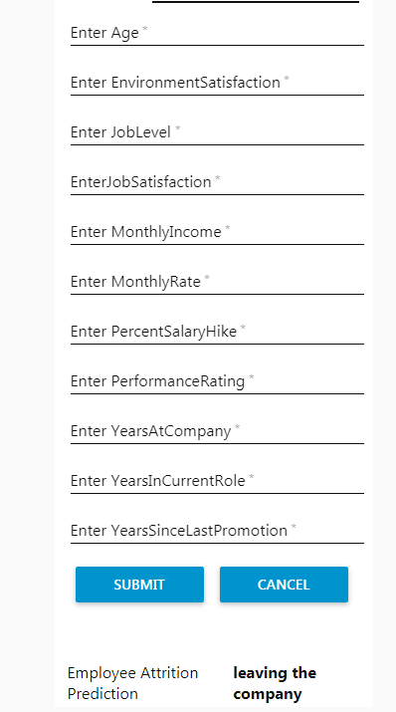
User Interface
Data

Slide 10
CONCLUSION
We used KNN and learned how it is to use while modelling the data
All the variables are contributing the most in attrition.
Predictive modeling can help HR departments predict employee attrition.

